Slide 1

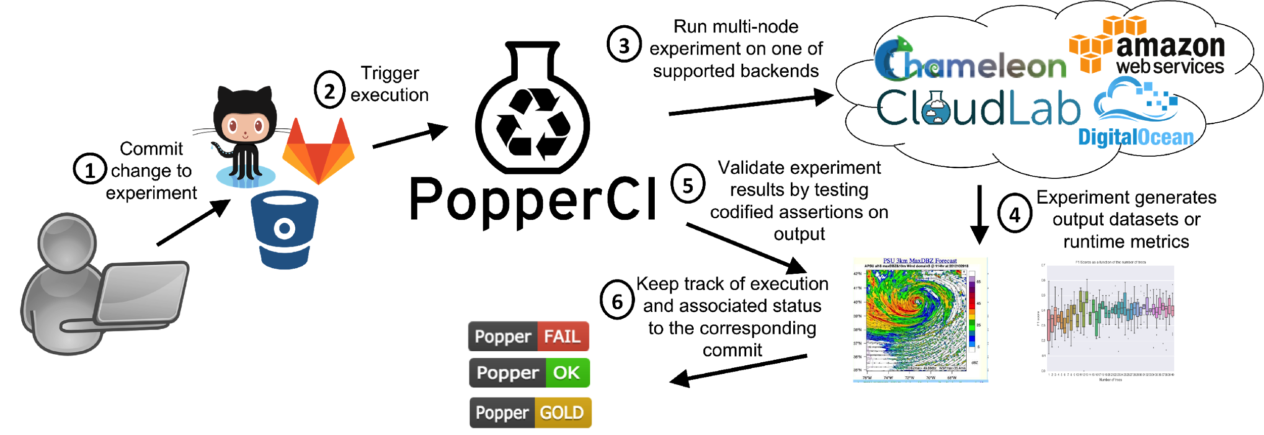


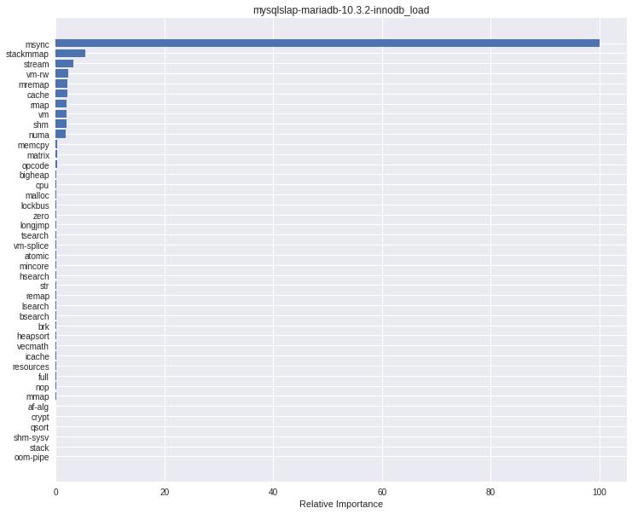
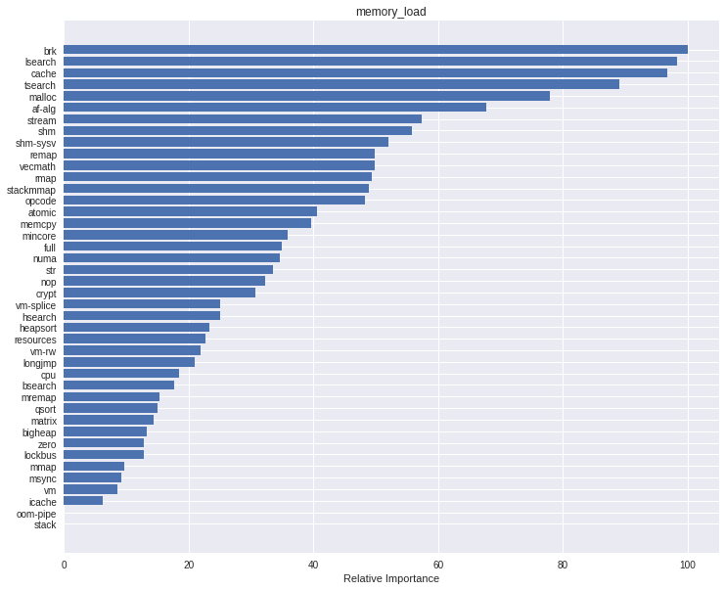
Run regression tests and obtain IRUPs
Trigger execution
a
Run regression tests and obtain FGRUPs.
Identify whether a regression occurred by comparing IRUPs
Push new commit
Identify whether a regression occurred
by automatically comparing FGRUPs.
4
Find root cause of regression
5
Find root cause of regression
VS.

Slide 2
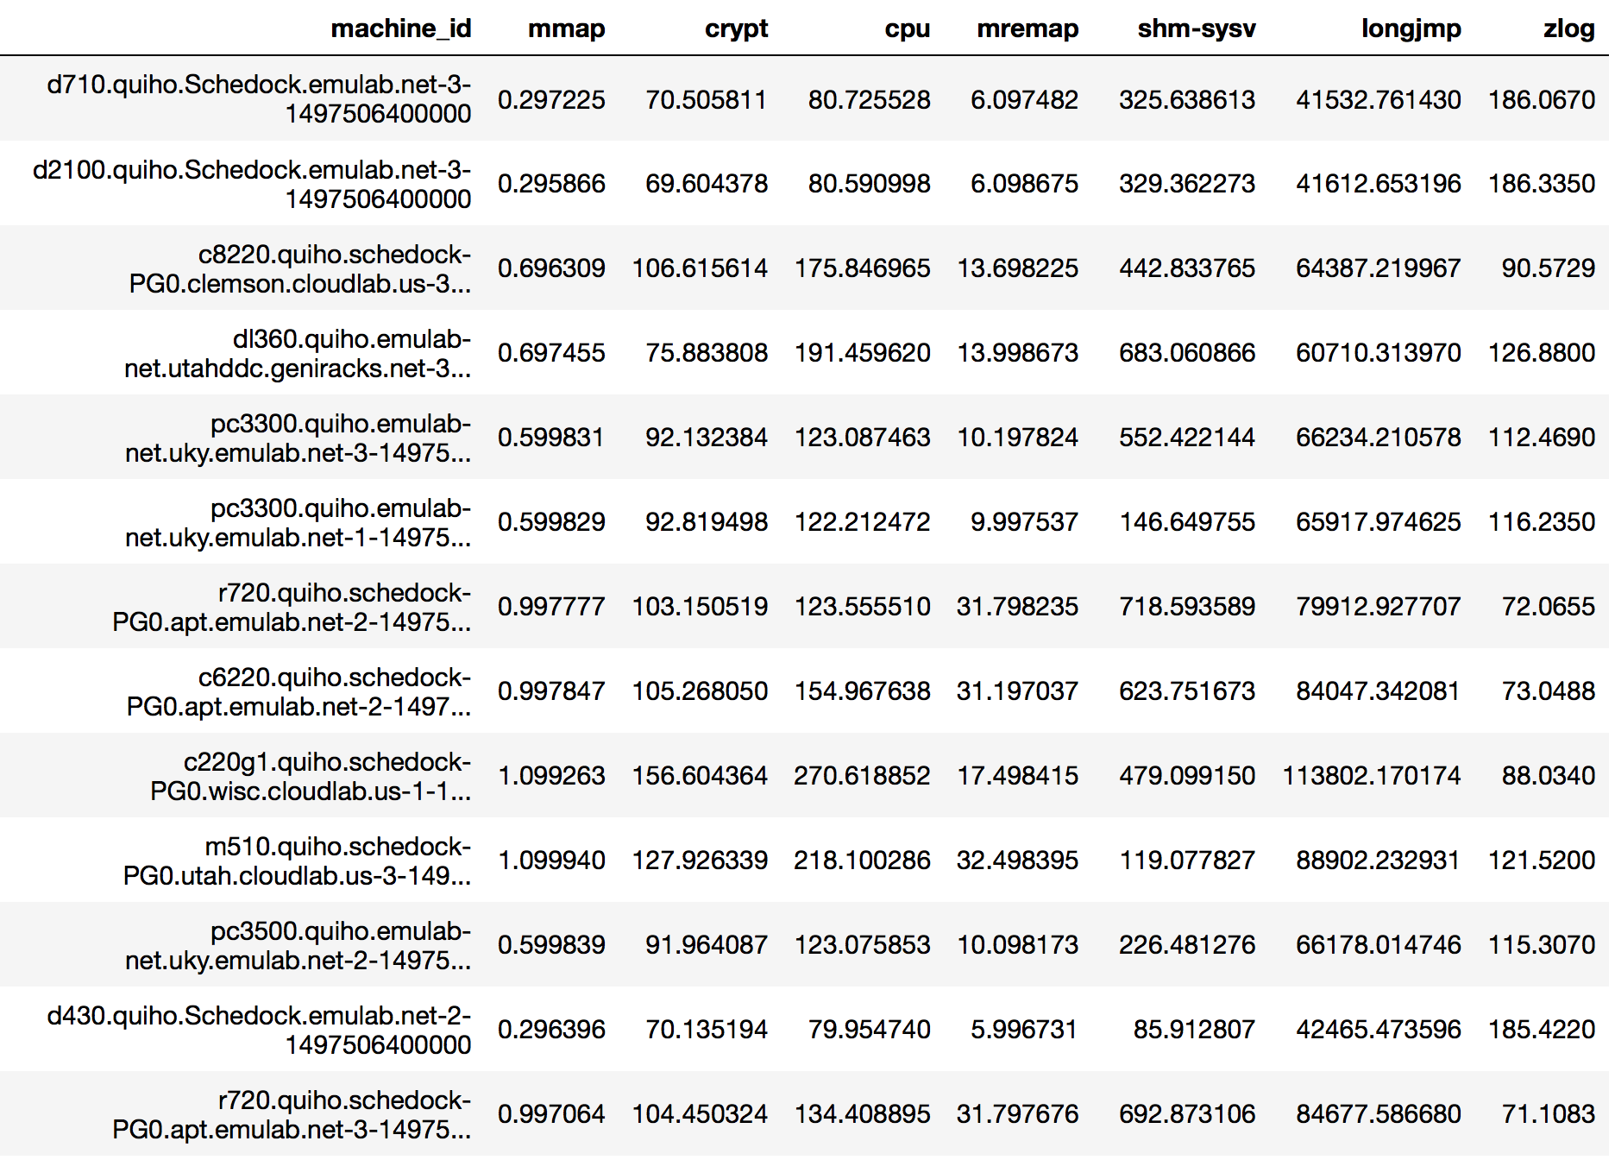
Variability patterns of an application (zlog), resemble the same variability pattern of one or more performance microbenchmark(s).

Slide 3
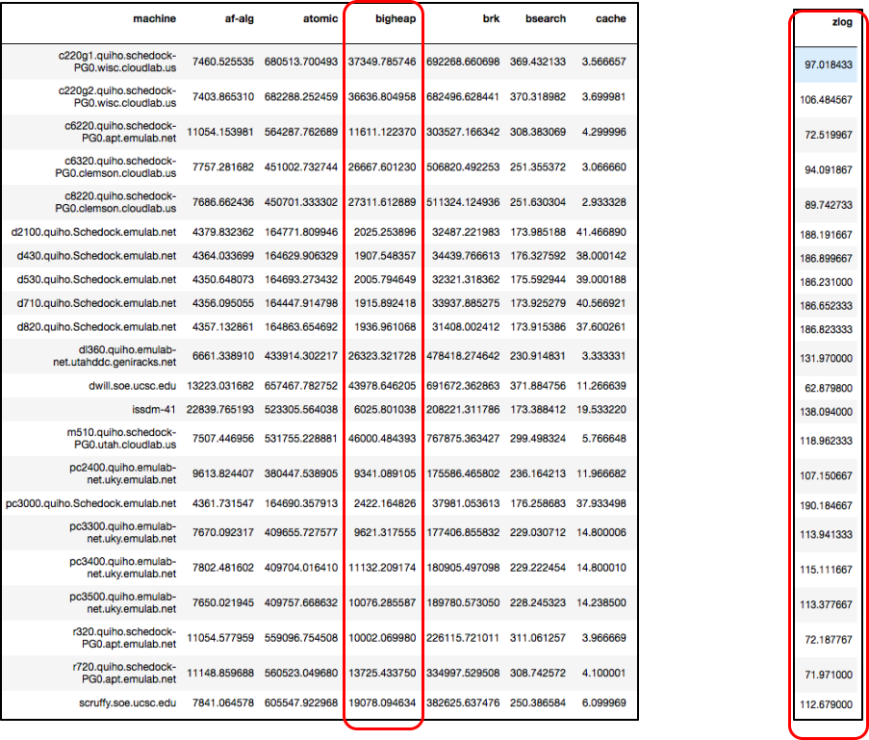
Obtain dataset of stress-ng performance vectors for each machine, as well as the performance vector corresponding to the application.
2
Create a prediction model via sklearn’s gradient boosting. This produces a tree ensemble.
3
X
y
Execute the battery of microbenchmarks (stress-ng), as well as the application being profiled, on all the available machines.
Create the IRUP by obtaining the relative ranking of feature importance out of the ensemble.
1
4

